Slide 1
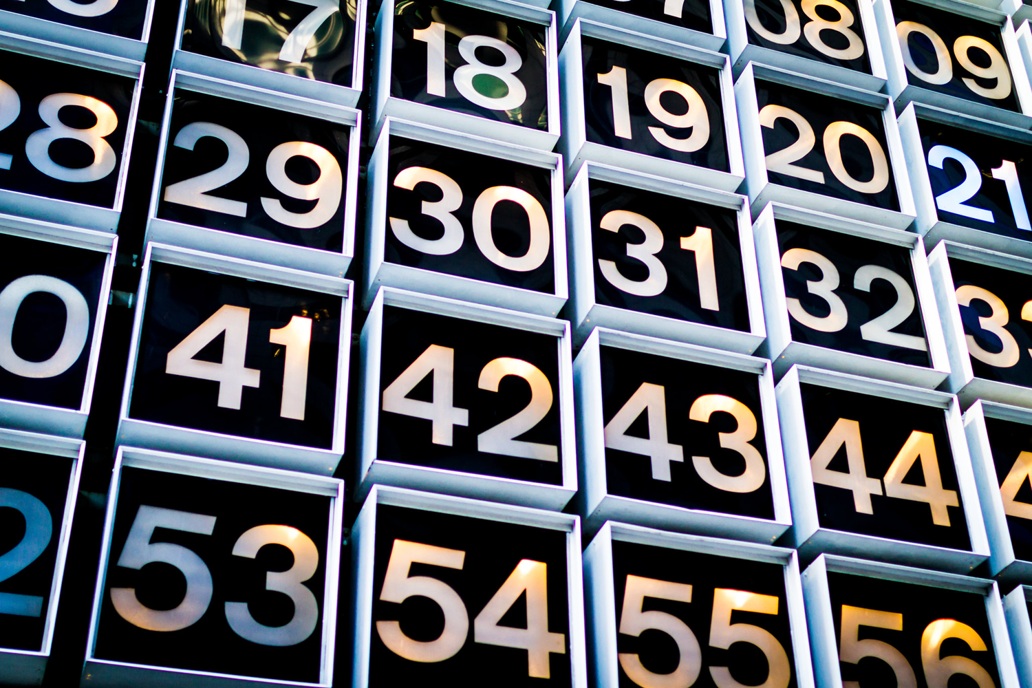

From Statistics to Decision Making
IL “Data and Decision Making” SS 26
Kami Höferl
(MervC, CC-BY-NC 2.0)

Slide 2
Overview
From Statistics 2 Decision Making
An Exercise in Rationality
A Look at Descriptive Approaches 2 Decision Making
Data-Based Decision Making in Real Life
CBA - The Old Man of Data-Based Decision Making
Your 2. Assignment
(MervC, CC-BY-NC 2.0)
(Escher, 1961)

Slide 3
From Statistics 2 Decision Making

Slide 4
But: Why Data Driven … Everything?
Not Everything: But management
“Management is a distinct process consisting of planning, organising, actuating, and controlling, performed to determine and accomplish stated objectives.” (Terry 1953)
“To manage is to forecast and plan, to organise, to command, to coordinate and to control.” (Fayol 1916)
👉 ideally: based on hard empiric evidence = data

Slide 5
But: Why Data Driven … Everything?
Reduces reliance on intuition, hierarchy or anecdote
Improves decision quality through systematic data analysis
Makes assumptions transparent & testable
Helps identify real drivers of performance and risk
Enables evaluation of strategic alternatives before committing resources
Supports learning from past decisions through measurable outcomes
Strengthens accountability towards stakeholders
Increases organisational credibility and legitimacy
Improves adaptability in dynamic and uncertain environments
Aligns strategy with measurable impact rather than opinion

Slide 6
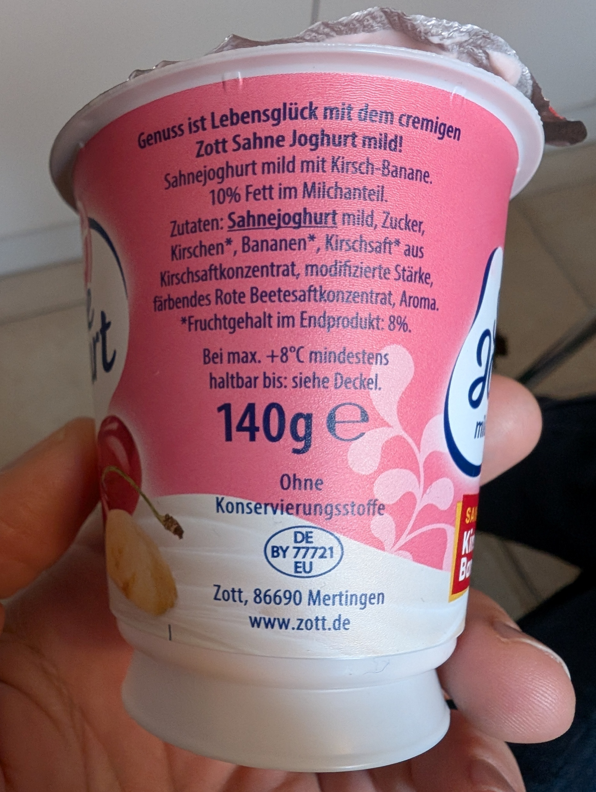
Data Driven … Everything?

Slide 7

Data Driven … Everything?

Slide 8
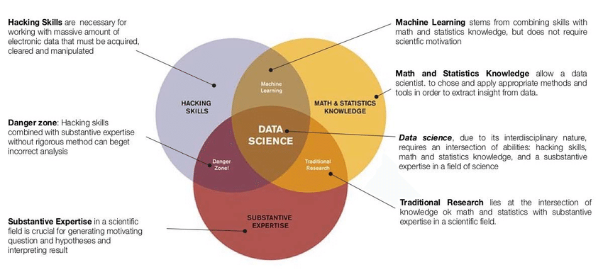
From Statistics to Data Science

Slide 9
Statistics vs. Data Science
Statistics:
👉 Gaining knowledge & testing hypotheses
Planned data collection & sampling design
Explanation of correlations, causalities and uncertainties
Model-based analysis
Focus on inference, significance & interpretation
Data Science:
👉 Pattern recognition, prediction & decision support
Use of large, unstructured data sets
Strong emphasis on data validation & exploration
Use of machine learning & algorithmic methods
Focus on performance & scalability

Slide 10
Let`s Start with the Basics (yeah: Statistics)

Slide 11
A typical Workflow
Reduction
Imputation
Aggregation
Classification
Generalisation
Documentation
Encoding problems
Data types
Labels
Completeness
Missing Values
Plausibility
Collect
Repositories
Define research questions
Data acqui-sition
Import data
Explore & validate data
Modify data
Model data
Validate models
Evaluate models
Documentation
Summarise findings
Univariate
Bivariate
Multivariat
Segment data record
Sensitivity analysis
Explanatory power
Number of variables
Effect strength

Slide 12
What is a Decision?
🤔

Slide 13
A Decision
A decision is a choice you make when you have more than one option and the outcome is not yet certain.
An example: Should I take an umbrella today?
Two options
Uncertain weather 👉 risk
Choice affects outcome

Slide 14
A Decision
A deliberate choice among two or more alternative courses of action, made by an agent with defined preferences and objectives, based on available information about the state of the world and the anticipated consequences of each alternative.

Slide 15
A Decision
A deliberate choice among two or more alternative courses of action, made by an agent with defined preferences and objectives, based on available information about the state of the world and the expected consequences of each alternative.
Agent: Person or group in charge of the choice
Alternatives: ≥ two courses of action
Uncertainty: future consequences of actions often not known with certainty
Preferences / objectives: decision maker has goals against the outcomes can be evaluated
Information: decision makers uses data and/or beliefs about the world
Commitment: decision implies action

Slide 16
Two Ways to Think About Decision-Making
Prescriptive theories define how people should make decisions to achieve the best possible outcome 👉 logically and consistently
Prescriptive models assume a rational agent who weighs all options & picks the one with the highest expected value

Slide 17
The Foundations of Prescriptive (“Rational”) Decision Theory
John von Neumann and Oskar Morgenstern “Theory of Games and Economic Behavior” (1944)
Expected Utility Theory (EUT) — the idea that a rational decision maker should choose the option with the highest expected utility
weighting the utility of each possible outcome by its probability of occurring
Rationality:
choices can be represented by a utility function — preferences become mathematically measurable

Slide 18
The Foundations of Prescriptive (“Rational”) Decision Theory
Rationality axioms 👉 set of logical rules that consistent preferences must follow
Completeness: a comparison of two options & stating a preference for one of them is always possible
No option = ‘incomparable’
Transitivity: preferences = logically consistent
If A is preferred over B, and B to C 👉 A must be preferred to C
Continuity: small enough chance of the worst outcome but you would still accept the gamble for a shot at the best outcome
Independence: if A is preferred to B, then a lottery involving A should be preferred to the same lottery involving B
Adding identical options to both does not change the preferences
Notes:
You prefer €1000 (A) over €10 (B) over €0 (C) — continuity says there is some probability p, say 0.98, at which you are indifferent between receiving €10 for certain and a lottery paying €1000 with 98% chance and nothing with 2%

Slide 19
Does it work?
🤔

Slide 20
An Exercise in Rationality

Slide 21
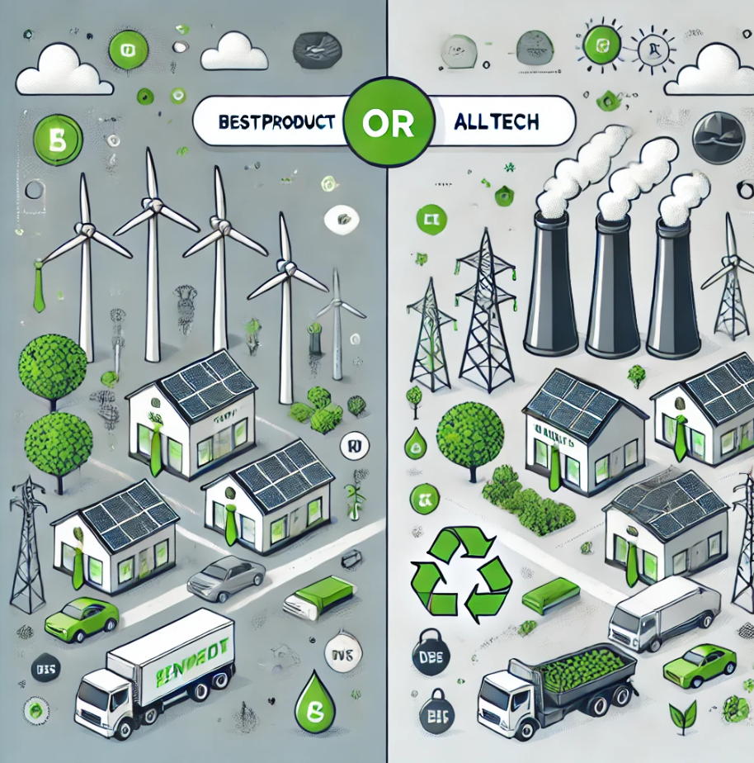
Welcome board members!
AllTech Ltd.
BestProduct Inc.
👉 Your 2 tasks:
🤔 invest in renewable energy to transition away from fossil fuels or continue relying on cheaper, non-renewable energy sources to maximize short-term profits
Secure the rentability of your company

Slide 22
Welcome board members!
10 rounds:
Invest in Renewables:
This involves significant upfront costs (e.g., installing solar panels, wind turbines, or upgrading infrastructure) but reduces emissions and aligns with consumer expectations. Long-term rewards include gaining market trust and avoiding future regulatory penalties.
Not invest in Renewables:
This option avoids immediate expenses, allowing the company to maintain competitive prices and higher profits in the short term. However, it risks reputational damage, regulatory fines, and consumer backlash in the future.

Slide 23
Again: Welcome board members!
10 rounds:
Invest in Renewables:
This involves significant upfront costs (e.g., installing solar panels, wind turbines, or upgrading infrastructure) but reduces emissions and aligns with consumer expectations. Long-term rewards include gaining market trust and avoiding future regulatory penalties.
Not invest in Renewables:
This option avoids immediate expenses, allowing the company to maintain competitive prices and higher profits in the short term. However, it risks reputational damage, regulatory fines, and consumer backlash in the future.
Now with 2 negotiators!

Slide 24

Outcomes of your decisions:

Slide 25
Outcomes of your decisions:
 |  | Company B: BestProduct Inc.
 |  | Invest in Renewables (Cooperate) | Stick with Fossil Fuels (Defect)
Company A: AllTech Ltd | Invest in Renewables (Cooperate) | (5, 5): Both cooperate; gain long-term stability and consumer trust. | (1, 7): A invests at a high cost, while B profits short-term by avoiding investment.
 | Stick with Fossil Fuels (Defect) | (7, 1): A profits short-term while B incurs renewable energy costs. | (3, 3): Both compete, avoiding investment but face cumulative penalties over time.

Slide 26
Debriefing
Why did you choose to cooperate or compete?
How did your choices affect the outcome?
What would encourage cooperation in real-world scenarios?
e.g., regulations, subsidies, consumer pressure, Xtinction Rebellion, …

Slide 27
Some Conclusions on the EUT
Rational individual decisions ≠ guarantee optimal collective results
EUT treats decisions in isolation
No interdependence of decisions between agents
Real people cooperate far more than EUT would predict
Indication for “bounded” rationality
Trust, context & social norms have influence

Slide 28
A Look at Descriptive Approaches

Slide 29
Two Ways to Think About Decision-Making
Prescriptive theories define how people should make decisions to achieve the best possible outcome — logically and consistently
Prescriptive models assume a rational agent who weighs all options and picks the one with the highest expected value
Descriptive theories explain how people actually make decisions in real life — including biases, shortcuts, and emotions
Descriptive research finds that humans often deviate from rational ideals (e.g. overconfidence, loss aversion, following the crowd)
👉 In practice, data-driven decision support aims to bridge the gap: helping real people (descriptive) make better, more rational choices (prescriptive)

Slide 30
Descriptive Decision Theory: How People Actually Decide
Herbert Simon’s “Bounded Rationality” (1950s): people do not optimise, the satisfice
Choosing the first “good enough” option due to limited time, information & cognitive capacity
Daniel Kahneman’s & Amos Tversky’s “Prospect Theory” (1979) & “Heuristics and Biases Framework”: people evaluate outcomes relative to a reference point
Loss averse, distortion of probabilities
Use of mental shortcuts (“heuristics”) :👉 simplify decisions, with systematic biases
Anchoring, availability, representativeness
Kahneman’s (2011) “Thinking, fast and slow”:
System 1: fast, automatic, intuitive
System 2: slow, deliberate, analytical

Slide 31

Since we are Here: A Recommendation

Slide 32
Some selected Effects when People make Decisions
Veblen effect: demand for a good increases as its price rises because high price signals status and exclusivity
Anchoring Effect: the first piece of information encountered disproportionately shapes all subsequent judgments, even if arbitrary
Framing Effect: identical information presented differently (e.g. "90% survival" vs "10% mortality") leads to systematically different choices
Sunk Cost Fallacy: people continue investing in failing projects because of resources already spent rather than future costs and benefits
Bandwagon Effect: people adopt beliefs or behaviours simply because others do, ignoring independent evaluation of options

Slide 33
When we are so bad at it: Why not Data Driven Everything?

Slide 34
Data Driven Decision Support: Navigating between Prescriptive and Descriptive Perspectives
Data driven approaches = bridge the gap how we should and actually do decide
Data driven ≠ guarantee for rational decisions
Limitations in data & analysis
Uncertainty reduction: better data = better probability estimates
Dashboards & visualisations: make relevant data explicit & comparable
Counteracting overconfidence & availability bias
Algorithms, models & methods: remove framing effects, anchoring & emotional distortion
👉 not replacing humans, but making them more rational, better informed, and less bias-prone

Slide 35
Data-Based Decision Making in Real Life

Slide 36
An Overview on Data-Driven Decision Strategies
Optimisation-Based Approaches
Cost-Benefit Analysis (CBA): quantifies & compares total expected costs & benefits of alternatives in $
Utility Analysis (UA): evaluates alternatives by measuring & comparing the subjective value (utility) each outcome delivers to the decision maker
Multi-Criteria Decision Analysis (MCDA): scores & weights alternatives across multiple competing criteria simultaneously
Probability-Based Approaches
Expected Value Analysis: weights possible outcomes by their probability to identify the optimal choice
Decision Tree Analysis: maps out sequences of decisions & uncertain events visually, calculating expected values at each branch

Slide 37
An Overview on Data-Driven Decision Strategies
Model-Based Approaches
Simulation & Scenario Analysis: models complex systems under different assumptions to explore a range of possible outcomes
Sensitivity Analysis: tests how robust a decision is by systematically varying key input parameters
Optimisation Models: mathematically identifies the best solution given defined constraints & objectives
Behaviourally Informed Approaches
Nudging & Choice Architecture: designs the decision environment using descriptive insights to guide better choices
Scorecard & Checklist Methods: structured tools that counteract cognitive bias by enforcing systematic evaluation

Slide 38
CBA - The Old Man of Data-Based Decision Making

Slide 39
Cost-Benefit Analysis: The Main Approach
👉 Main idea: systematically compare
total expected costs and
total expected benefits of a decision alternative
to determine whether it is worthwhile
Some Pros & Cons:
👍 make all assumptions explicit and comparable 👉 reducing the influence of intuition and bias
👎 not all costs & benefits can be easily quantified or moneti$ed
👎 results = sensitive to the chosen discount rate & assumptions

Slide 40
Cost-Benefit Analysis: The Main Approach
How 2:
Step 1: Define the decision: clearly specify what action or investment is being evaluated and from whose perspective (individual, organisation, society)
Step 2: Identify all costs: list all direct and indirect costs including financial, time, resource, and opportunity costs
Step 3: Identify all benefits: list all direct and indirect benefits including financial returns, time savings, risk reductions, and intangible gains
Step 4: Quantify and monetise: convert all costs and benefits into a common unit (most often: 💰💸💲) 👉 make them comparable

Slide 41
Cost-Benefit Analysis: The Main Approach
Step 5: Account for time: future costs & benefits are discounted to their present value using a discount rate
money today = worth more than money tomorrow
Step 6: Calculate the net benefit: subtract total costs from total benefits
positive net benefit (= Benefit-Cost Ratio ≥ 1) 👉 the decision is ‘worthwhile’
Step 7: Compare alternatives: apply the same process to all alternatives
👉 select option with highest net benefit or highest Benefit-Cost-Ratio

Slide 42

An Example: Let’s build some PV!
Should a Company Install Solar Panels on its Factory Roof?
A mid-sized manufacturing company is considering investing in a rooftop solar panel system. The decision makers needs to evaluate whether the investment is financially worthwhile over a 10-year horizon.

Slide 43
Detour: Emissionszertifikatehandelsgesetz 2022 (NEHG 2022)
NEHG imposes a tax of fossil energy carriers (oil, gas, etc.) in sectors outside the EU-ETS I (= industry)
Including buildings, transport & small industrial installations
CO2-tax = paid by energy suppliers 👉 pass costs on to customers
Look out for “CO₂-Bepreisung gemäß NEHG” 😉
Fixed prices per tonne CO₂: €30 (2022) 👉 €35 (2023) 👉 €45 (2024) 👉 €55 (2025)
From 2028 on: EU-ETS II with market-based pricing

Slide 44
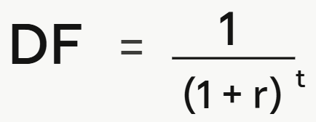
Detour: Discount Rate
Why?
€1 today is worth more than €1 in the future 👉 money today can be invested and earn a return
converts future cash flows into today's euros 👉 making costs and benefits from different points in time comparable
The formula for the Discount Factor:
r … discount rate and
t … year

Slide 45
Detour: Discount Rate
An Example at r = 5%
Year 0: DF = 1.000 / no discounting, this is the present
Year 1: DF = 0.952 / €1 in Year 1 is worth €0.95 today
Year 5: DF = 0.784 / €1 in Year 5 is worth €0.78 today
Year 10: DF = 0.614 / €1 in Year 10 is worth only €0.61 today

Slide 46
Your 2. Assignment

Slide 47
Your 2. Assignment: A little CBA for IMC
Your task: Evaluate two alternative PV investments scenarios @ IMC using CBA:
Both plants should cover 50% of IMC’s Building G total annual electricity demand (~ 325 MWh)
Plant A: rooftop-based PV plant, 20 years lifespan
Plant B: ground-mounted PV plant, 20 years lifespan

Slide 48
Your 2. Assignment: How 2 Proceed
Step 1: Size the installations
Based on the target coverage of 50% 👉 calculate the required installed capacity in kWp
Use standard assumptions for solar yield in Austria
Step 2: Estimate costs
Research or estimate realistic installation costs per kWp for Austria
Estimate annual maintenance costs
Assume a total system lifetime of 20 years
Step 3: Estimate benefits
Annual energy cost savings based on avoided grid electricity purchase
Avoided carbon cost based on NEHG 2022: assume €55/tonne CO₂ in 2025
Based on the total electricity demand: estimate the saved t CO2 based on the average electricity footprint per kWh

Slide 49
Your 2. Assignment: A little CBA for IMC
Step 4: Build the CBA model
Set up a discounted cash flow model in Excel 👉 use the one from class
Apply a discount rate (suggested: 5%)
Calculate NPV and Benefit-Cost Ratio for both scenarios
Step 5: Compare and decide
Compare NPV and BCR across both scenarios
Identify which scenario is financially more attractive
Discuss which assumptions most strongly influence the result

Slide 50
Your 2. Assignment: A little CBA for IMC
Your report: A4, PDF, “Group_XY.pdf” 👉 Folder “2. Assignment”
Cover page
Recapitulate your task
Document your steps 1 to 5:
Which assumptions were made?
Which deductions did you draw?
Max. 7 pages
Your CBA Excel: “Group_XY.xlsx” 👉 Folder “2. Assignment”
📅 Deadline: 05.06.2026; 12:00

Slide 51
Utility Analysis

Slide 52
Multi-Criteria Utility Analysis: The Main Idea
👉 Main idea: evaluate and compare alternatives
not by a single monetary value,
but scoring them across multiple criteria simultaneously
each weighted by its relative importance to the decision maker
Result: weighted utility score per alternative 👉 highest total score = preferred
not everything needs to be converted into € 👉 criteria can be measured in different units (€, CO₂, quality, time, …)

Slide 53
Multi-Criteria Utility Analysis: The Main Idea
Some Pros & Cons:
👍 handles incommensurable criteria 👉 no forced monetization
👍 makes decision maker's priorities explicit 👉 reduces hidden value judgements
👎 weights & utility functions = subjective 👉 different decision makers = different conclusions
👎 sensitive to how criteria are scaled & assigned weights

Slide 54
Multi-Criteria Utility Analysis: The Workflow
Define the decision: specify alternatives to be compared
Identify the criteria: list all dimensions that matter for the decision maker
e.g. cost, environmental impact, feasibility, quality, etc.
Weight the criteria: assign each criterion a weight reflecting its relative importance
weights sum to 1 (or 100%)
Define utility functions: for each criterion, define how raw scores (e.g. € costs, CO₂ tonnes, satisfaction ratings) translate to a utility value
e.g. normalised utility between 0 (worst) and 1 (best)

Slide 55
Multi-Criteria Utility Analysis: The Workflow
Score each alternative: for each criterion measure/estimate the performance of every alternative 👉 convert it into a utility value using Step 4
Calculate weighted utility scores: multiply each criterion's utility value by its weight 👉 sum across all criteria = total utility score per alternative
Compare alternatives & decide: alternative with highest total weighted utility score = preferred choice
Conduct a sensitivity analysis: test robustness of results
vary key weights 👉 changes in the ranking

Slide 56
Outlook

Slide 57
Outlook
We need MAXQDA:
https://imcfhkrems.sharepoint.com/sites/IT-Online/SitePages/de/Softwarecatalog.aspx
Then: https://imcfhkrems-my.sharepoint.com/:f:/g/personal/software_imc-krems_eu/EpbZ0LmrhJ5ElO9wUDSTtzoBz2GmujDB2SkbqGL3yiwLGw?e=Us9B2P

Slide 58


So long & cheerio!

